Slide 1
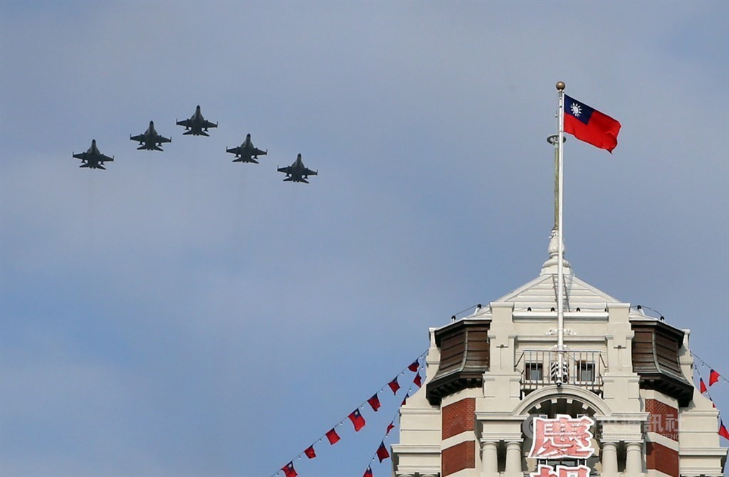
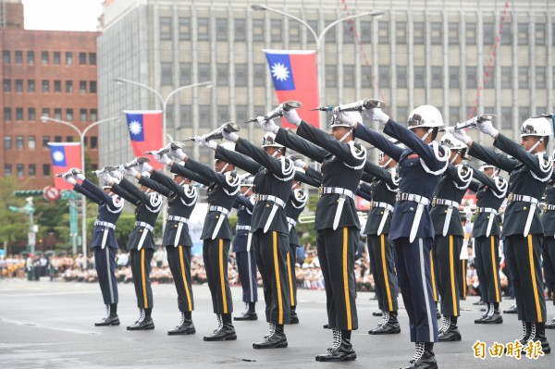
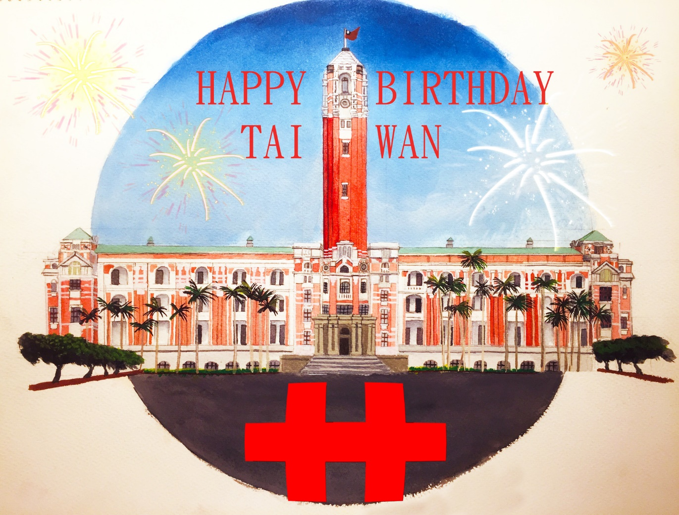
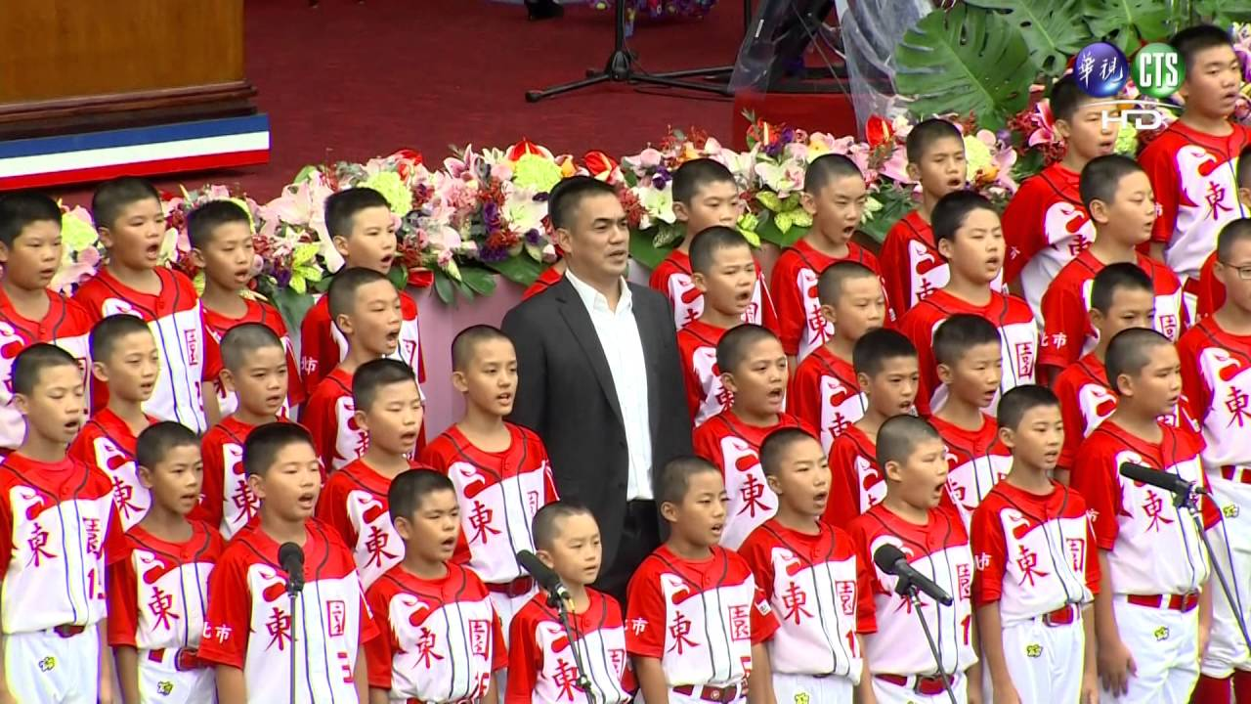
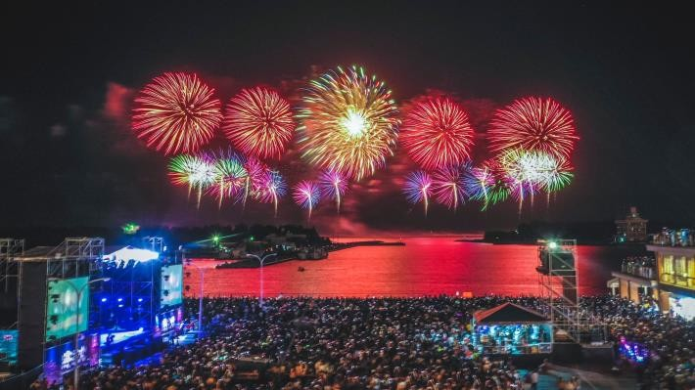
National Day Double Tenth Day
flag-raising ceremony
military parade
Sing National Anthem
Presidential Building
fireworks

Slide 2
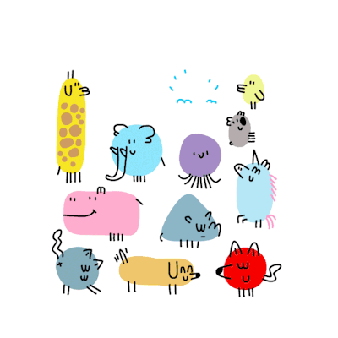
Animals’ Policy Presentation

Slide 3
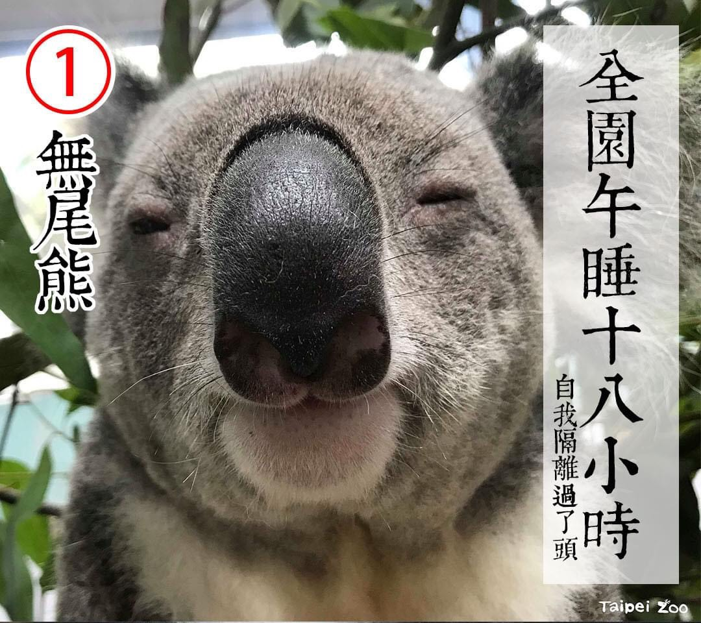
koala

Slide 4
lemur

Slide 5
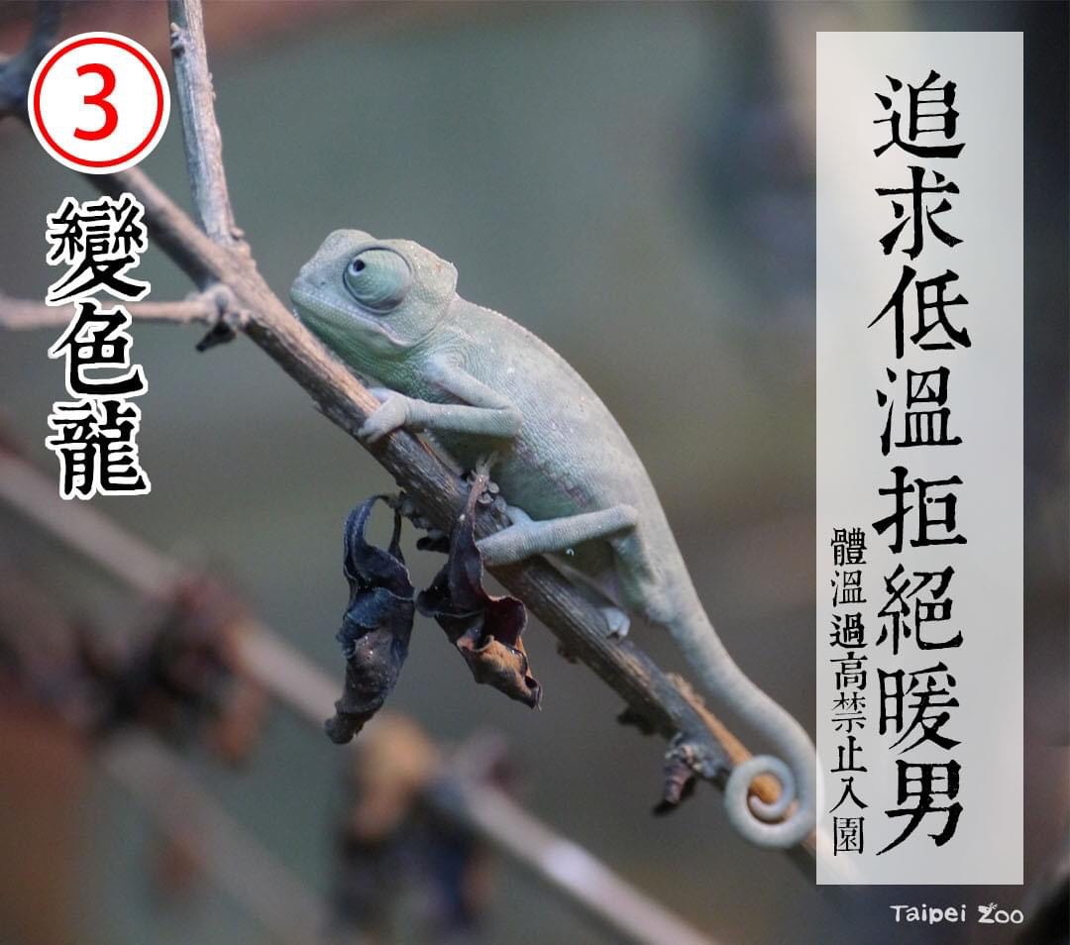
chameleon

Slide 6
leopard

Slide 7
slow loris

Slide 8
capybara

Slide 9
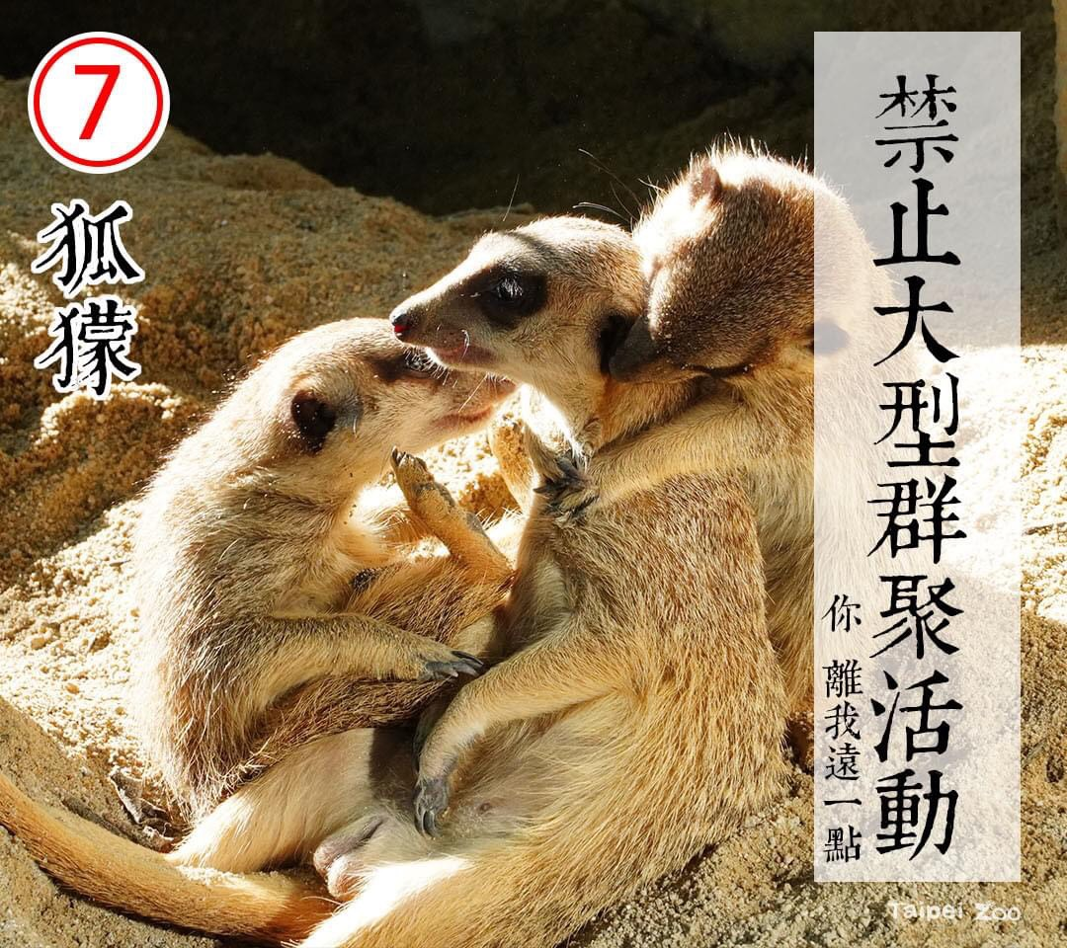
meerkat

Slide 10
raccoon

Slide 11
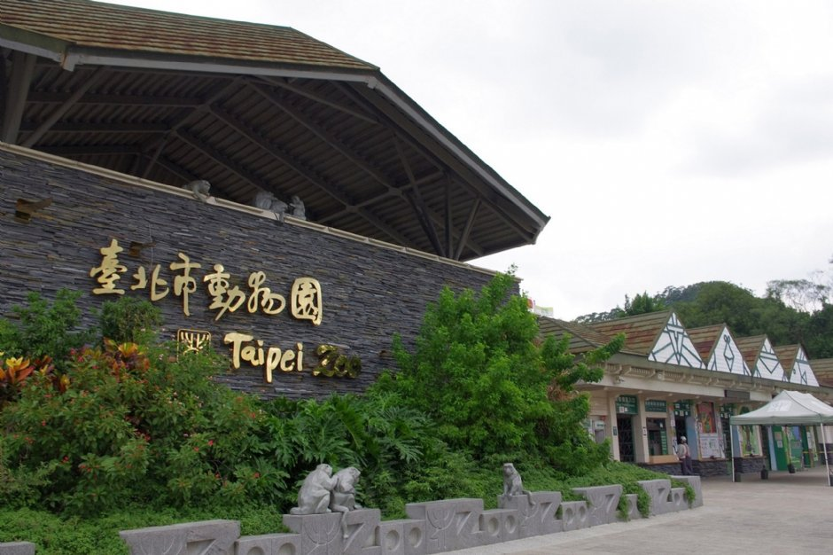
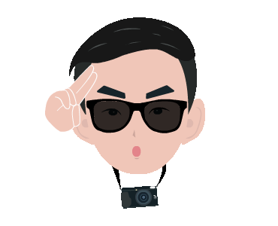
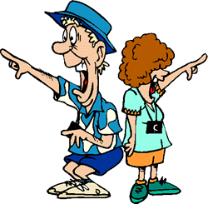
How was your field trip in Taipei Zoo?

Slide 12
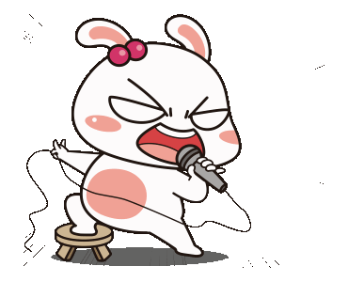
Did you do your homework?
Of course!

Slide 13
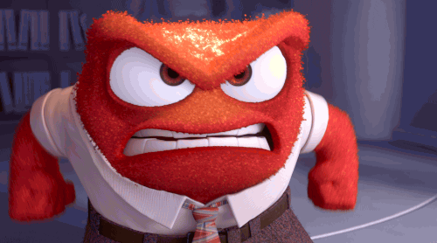
angry
mad
piss off
hit the ceiling

Slide 14
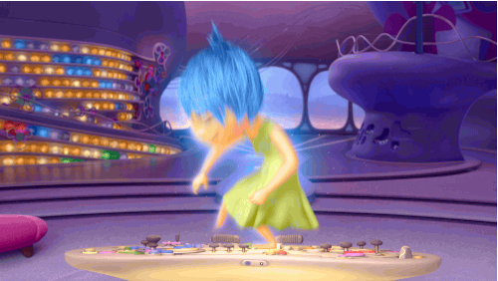
happy
glad
joyful
over the moon

Slide 15
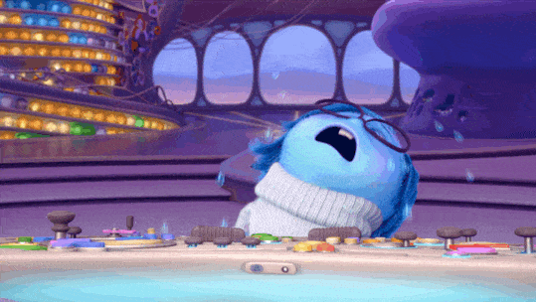
sad
down
blue
in a bad mood

Slide 16
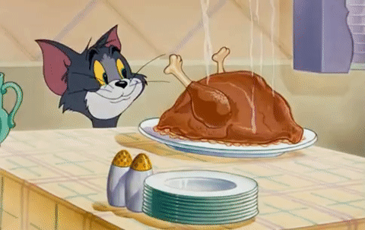
hungry
starving
I could eat a horse.

Slide 17
thirsty
parched
I’m drier than the desert.

Slide 18
sick
have a cold
I'm not feeling well.

Slide 19
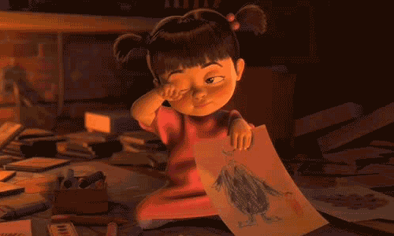
tired
sleepy
feel dog-tired

Slide 20
1
angry
2
happy
3
sad
4
hungry
5
thirsty
6
7
tired
sick

Slide 21
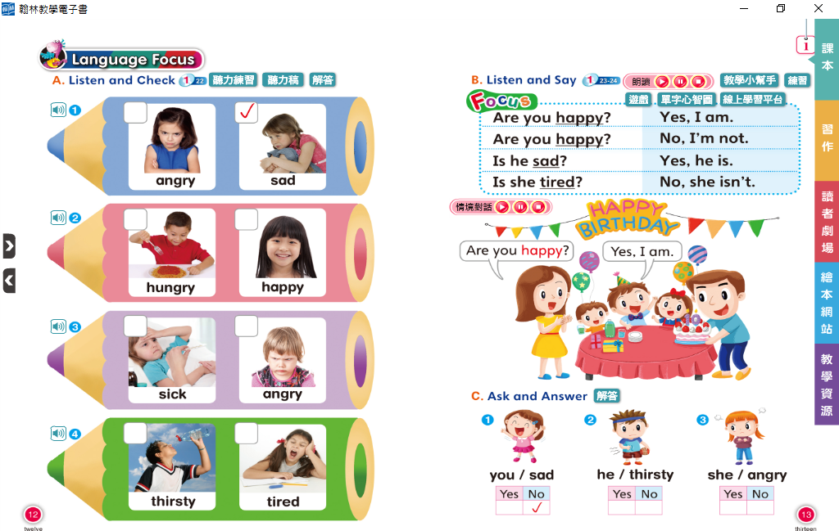

Slide 22
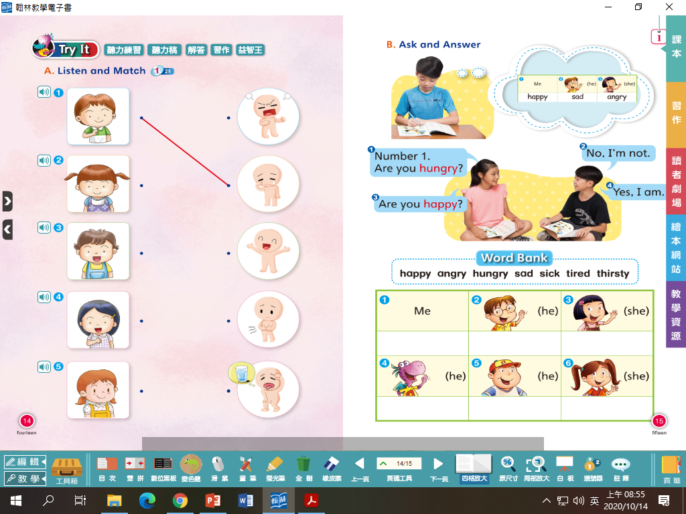

Slide 24
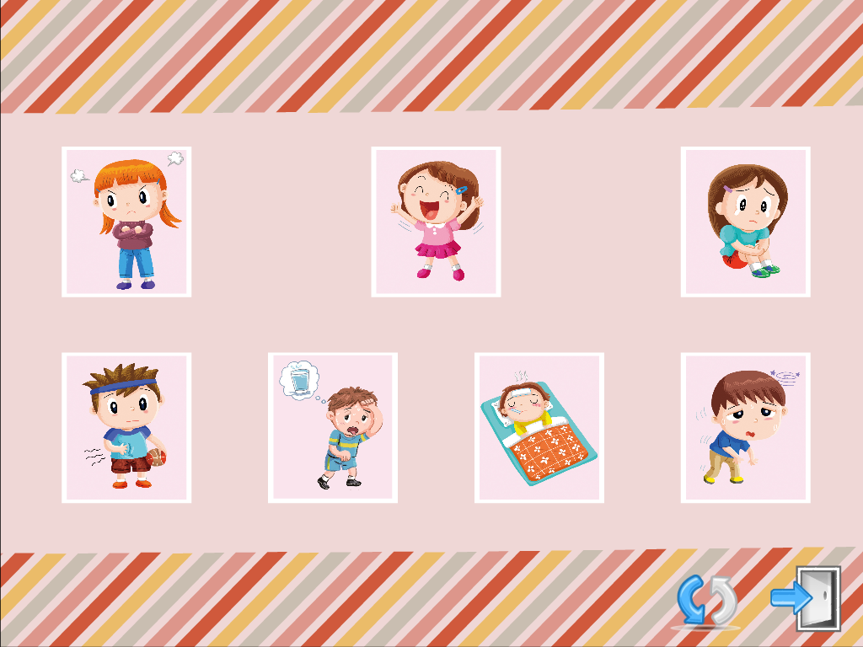
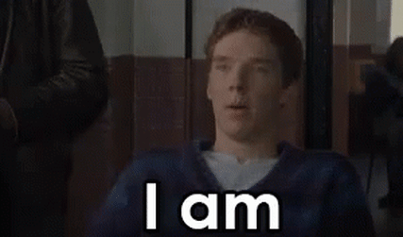
angry
happy
sad
hungry
thirsty
sick
tired

Slide 25
He is angry.

Slide 26
She is happy.

Slide 27
She is sad.

Slide 28
It is hungry.

Slide 29
He is thirsty.

Slide 30
It is sick.

Slide 31
She is tired.

Slide 32
P20

Slide 33
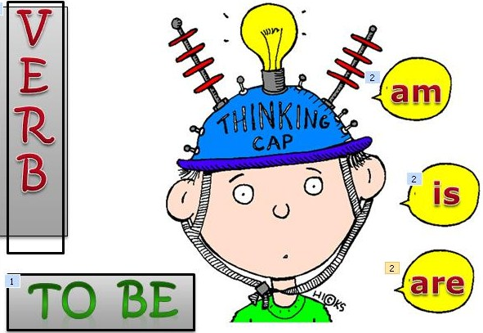
+
am
I
+
is
He
She
It
Mandy
+
are
We
You
They

Slide 34
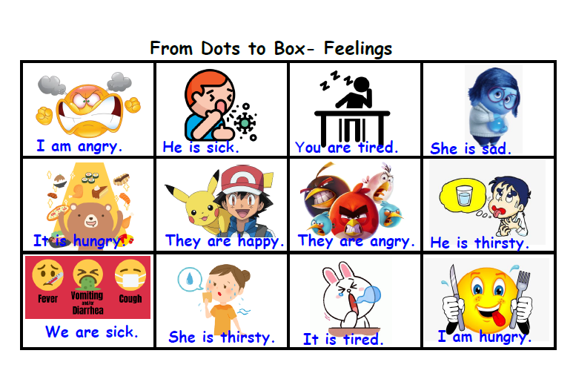

Slide 35
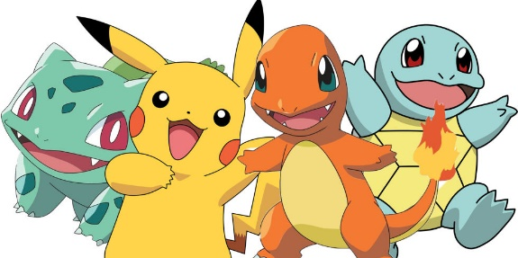
Homework this week
聽: CD1第26-31首。
說&讀:聽CD時跟著大聲唸。完成3遍
請家長在課本P19簽名可換印章。
寫: 完成英語習作P45-46，下週一交。
背: Unit 1單字，下週進行隨堂小考。

Slide 36
I am angry.

Slide 37
Are you angry?
Yes, I am.

Slide 38
Are you angry?
No, I’m not.
I’m happy.

Slide 39
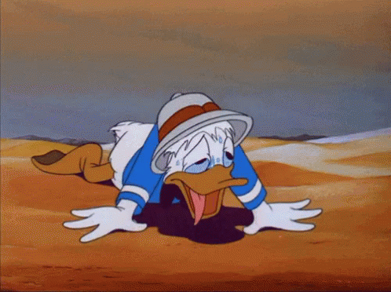
He is thirsty.

Slide 40
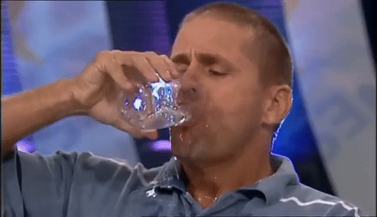
Is he thirsty?
Yes, he is.

Slide 41
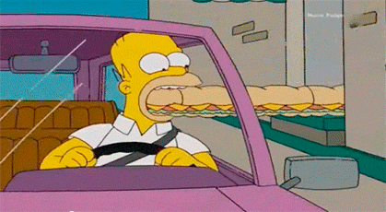
Is he thirsty?
No, he isn’t.
He’s hungry.

Slide 42
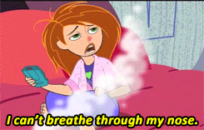
She is sick.

Slide 43
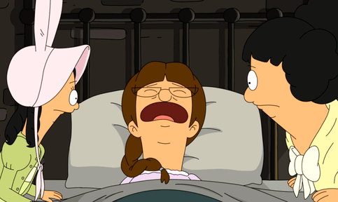
Is she sick?
Yes, she is.

Slide 44
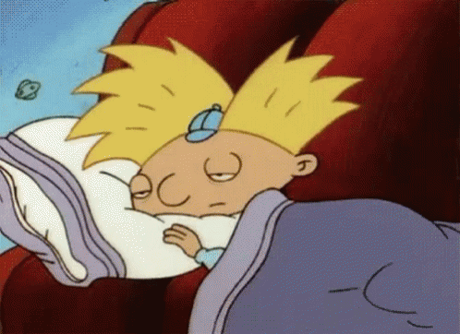
Is she sick?
Yes, she is.
She’s sick and tired.

Slide 45
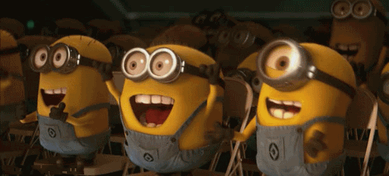
They are happy.

Slide 46
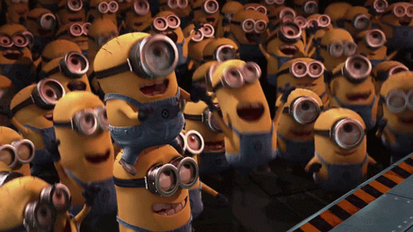
Are they happy?
Yes, they are.
They’re happy
and excited.

Slide 47
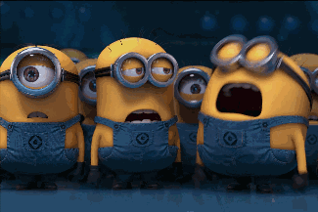
Are they happy?
No, they aren’t.
They’re sad
and frustrated.

